Slide 1

Bike Availability in Washington DC
Prepared By: Clare Cruz
Tristal Li
Zhuoheng Han
Wei-Yu Tseng
For client: Capital Bikeshare
Presented in class:
Perspectives in Data Science (36-601) & Professional Skills for Statisticians (36-611)
DATE: 11/17/2021

Slide 2
Executive summary
Data: June 2019 capital bike share trip data, Bike station location data
Bike availability (%): (# of bikes in a station)/(total bike capacity of that station) * 100%
Time: Dates, Hours in a day, Weekdays or Weekends
Location: Longitude & Latitude, City map of Washington DC
Methods: Exploratory data analysis (EDA) – Bar charts & Maps
Results & Conclusions:
Overall Bike availability over a day: Usually higher availability over night than daytime
Weekday vs. Weekend: Bike availability during working hours are significantly higher on weekdays than weekends
Bike availability in Washington DC: Higher bike availability in downtown than suburbs
Non-working vs working hours: Bikes are more gathered in downtown area during non- working hours, and spread out to suburbs during working hours

Slide 3
Data Description
Data origin: Historical data on Capital Bike usage⁽¹⁾
Data sets:
Capital bike share station locations
Capital bike share trip data during the month of June 2019 (To eliminate influence of Covid)
Main factors:
Bike availability (%): (# of bikes in a station)/(total bike capacity of that station) * 100%
Time: Dates, Hours in a day, Weekdays or Weekends
Location: Longitude & Latitude, City map of Washington DC
Main data manipulation steps:
Determine how many bikes are at each station at the beginning of June 2019
Calculate how many bikes were reshuffled and add data points for those transitions
Calculate number of bikes arrived and departed from each station for every hour
Focus on the difference between arrivals and departures, and made the cumulative sum
(1). Data accessed from: https://www.capitalbikeshare.com/system-data

Slide 4
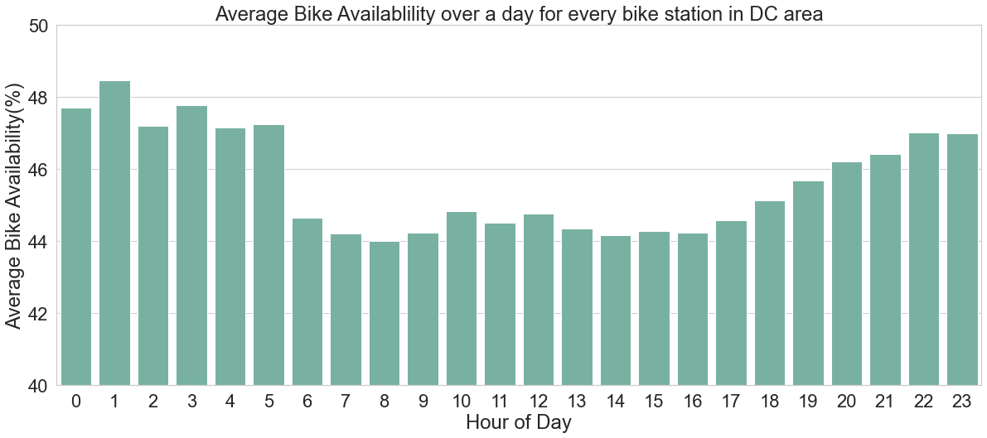
Overall Bike Availability in a Day
Higher average bike availability over night than daytime.
Bike availability decrease sharply at 6 a.m., and increase gradually between 17 and 22 p.m.
Possible reason: More bikes are in use during daytime; Working and living schedules

Slide 5
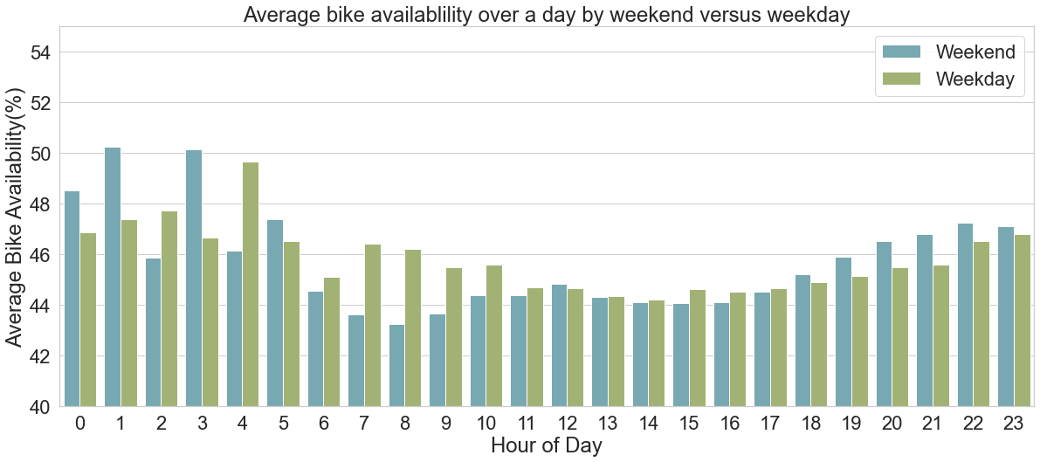
Weekday vs. Weekend

Slide 6
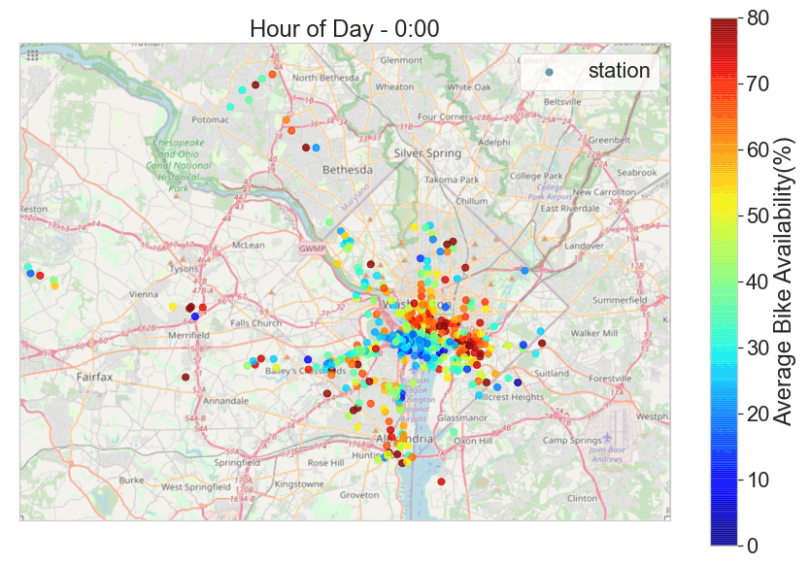
Bike Availability in Washington DC
Higher bike availability in downtown than suburbs
Possible reason: Larger population & more companies in downtown
Time in a day can influence the distribution of bike availability
Possible reasons: Working and living schedule; Distribution of residential and commercial areas
Some small “clusters” of bike stations in outskirts, usually have bikes only during working hours (See page 6)

Slide 7
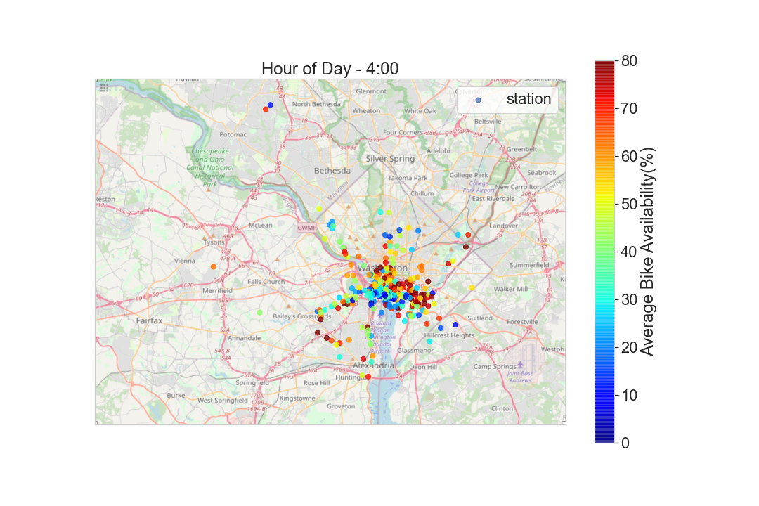
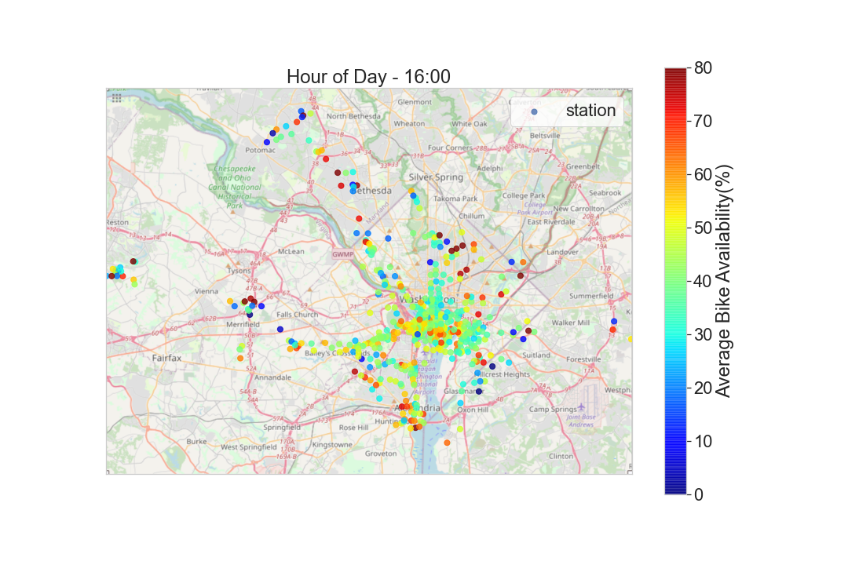
Non-working vs. Working Hours
Bikes are more gathered in downtown area during non-working hours
They spread out to several “clusters” in suburbs during working hours
Possible reasons: More residential areas in downtown; Several gatherings of companies in suburbs

